Slide 1

Analysis of Different Risk Factors Associated with Lung Cancer levels and Prediction Using Machine Learning Models
Presented by Group 9
Joandra De Souza,
Lisa Amsden,
Likhitha Arigala,
Naga Durga Harika Mareddy,
Leelamrutha Vanamu,
Yugala Ramula

Slide 2

Introduction
Globally, lung cancer ranks among the top contributors to cancer-related deaths. Understanding and identifying risk factors for cancer development is important for early detection and to improve screening and prevention strategies.
While smoking is the leading cause of lung cancer, there are several other risk factors that have been identified, including air pollution, occupational hazards, genetic predisposition, and lifestyle factors like diet. (Ahmad & mayya, 2020).
In a diagnostic assessment involving 120 individuals, 7.4% of them were found to have undergone the evaluation, and among those, lung cancer was diagnosed in 1.7% of the population. The distribution of these cases was 71% for stages I to II and 29% for stages III to IV (Darling et al., 2021).
The study will focus on analyzing dataset of cancer patients to identify the major risk factors associated with lung cancer.

Slide 3
AIM We aim to predict the association between various risk factors like air pollution, Obesity, dust allergy, passive smoking, and occupational hazards with the risk levels of lung cancer. This project will help us understand how these factors influence the lung cancer risk in a straightforward and accessible way.
PURPOSE
The primary objective is to analyze how factors like air pollution, dust allergies, passive smoking and occupational hazards have an impact on lung cancer and their risk levels. This study uses machine learning to predict risk factors and identify the high-risk factor likely to be causing lung cancer. This research will enable us to enhance early detection and prevention strategies, ultimately reducing the public health burden of lung cancer.

Slide 4
Hypothesis
Null Hypothesis : There is a no significant association between the risk factors (age, passive smoking, obesity, dust allergy, occupational hazards, genetic risk, air pollution) and the levels of lung cancer.
Alternate Hypothesis : There is a significant association between the risk factors (age, passive smoking, obesity, dust allergy, occupational hazards, genetic risk, air pollution) and the levels of lung cancer.

Slide 5
METHODOLOGY
Data Collection:
Data was collected from data.world
Source: https://data.world/cancerdatahp/lung-cancer-data
Data Storage and extraction:
We stored the data in the form of CSV files, Excel spread sheet and data extraction by using MySQL commands.
Data Cleaning:
Using MySQL and Python, we identified and addressed missing values, managing duplicate records, standardizing data formats and dropped the columns that were not required to analyze the data effectively and handled outliers.
Exploratory Data Analysis:
Using Python, performed descriptive statistics to summarize the characteristics of dataset and data visualization and statistical analysis.
Model Development:
Using different machine learning models like Random forest, Logistic regression, Decision trees for identifying best performance analyzing model for the dataset
Results:
Which risk factor has more influence on the outcome variable (risk of lung cancer) .
Which machine learning model is the best-suited model to predict the relationship between risk factors and outcome variable (cancer).

Slide 6
Description of data set variables
COLUMN NAME | DATA TYPE | DESCRIPTION
Patient_id | Numerical – Discrete | Unique number to each patient
Age | Numerical – Continuous | Age of the patients
Gender | Categorical – Nominal | Gender of the patients
air_pollution, Obesity occupational_hazards dust_allergy, alcohol_use, | Categorical – Ordinal | Risks factors associated with lung cancer
Risk level | Categorical – Ordinal | Lung-cancer risk levels

Slide 7
DATA DESCRIPTION
Patient-Id | 1000 Unique Values
Age | (Years)
Gender | 1 = male , 2 = female
Air Pollution | High levels of pollution (6–8), on a scale of (1–8)
Alcohol Use | On a scale of (1-8), high levels of alcohol use (6-8)
Dust Allergy | On a scale of (1-8), high levels of dust allergy (6-8)
Occupational Hazards | On a scale of (1-8), high levels of Occupational Hazards(6-8)
Genetic Risk | On a scale of (1–7), will be in the range of (5–7)
Obesity | On a scale of (1–7), will be in the range of (5–7)
Passive Smoker | On a scale of (1-8), high levels of alcohol use (6-8)
Level | High , Medium , Low

Slide 8

shared DATABASE IN MySQL

Slide 9
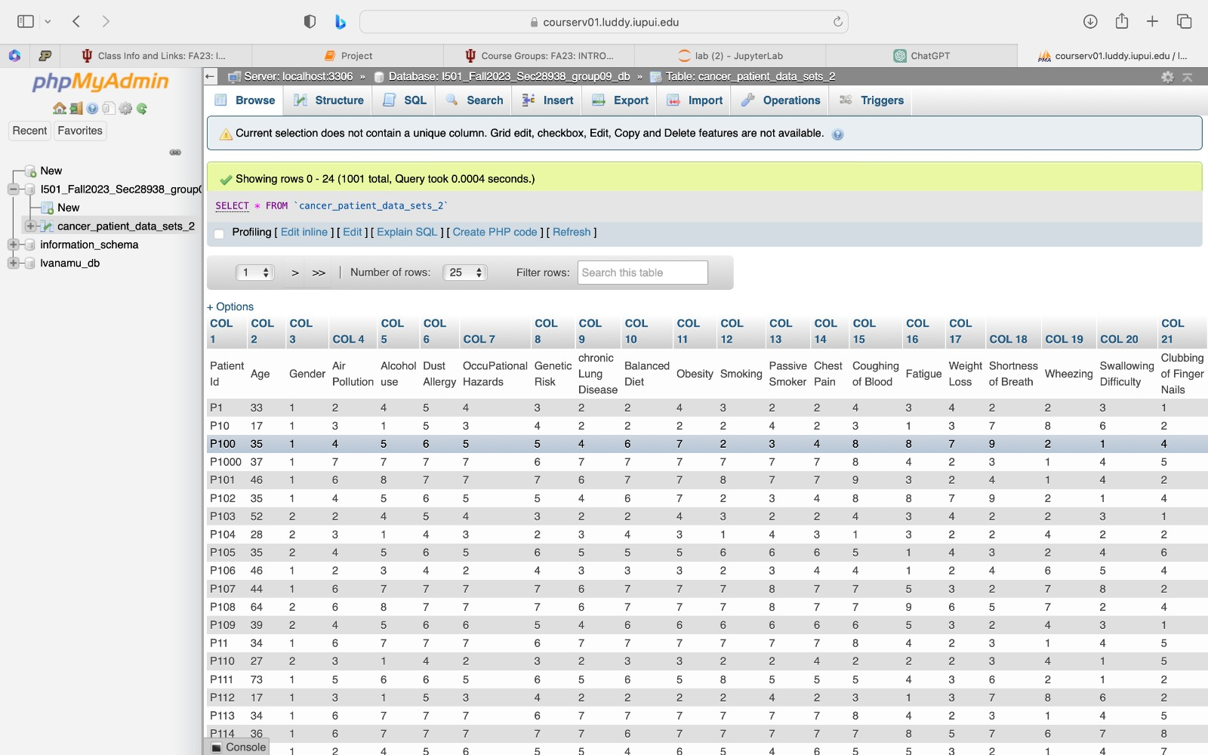
We imported our file cancer_patient_data_sets_2 in shared database I501_Fall2023_Sec28938_group09_db

Slide 10
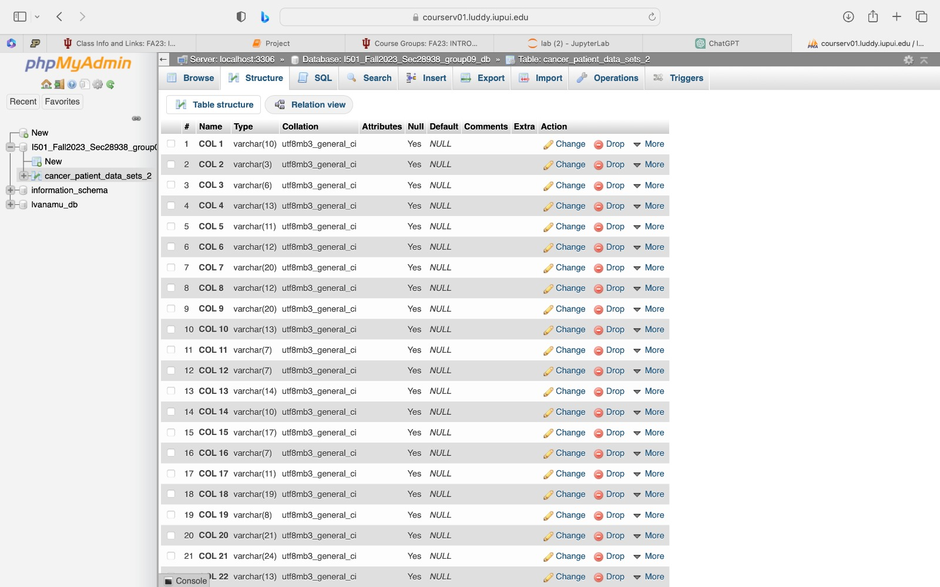
This is the structure of our data

Slide 11
Making A CONNECTION WITH MySQL AND PYTHON

Slide 12
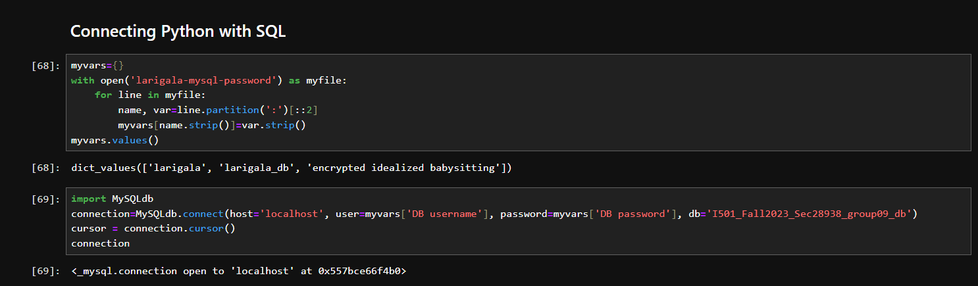
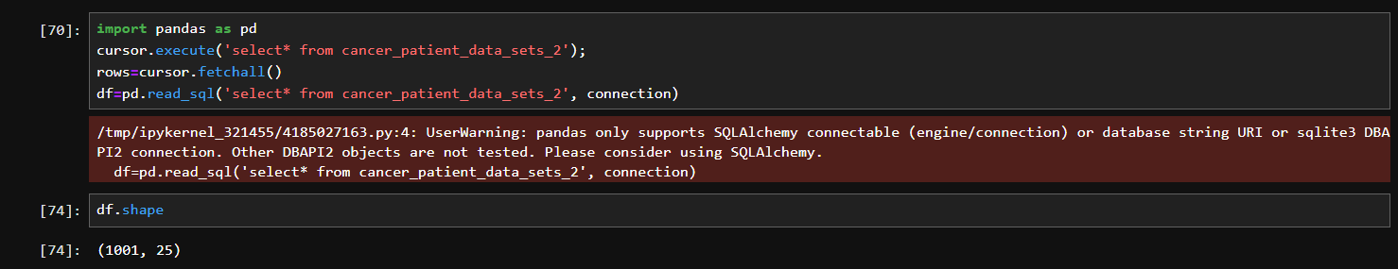
Our data has 1001 rows and 25 columns - used df.shape

Slide 13
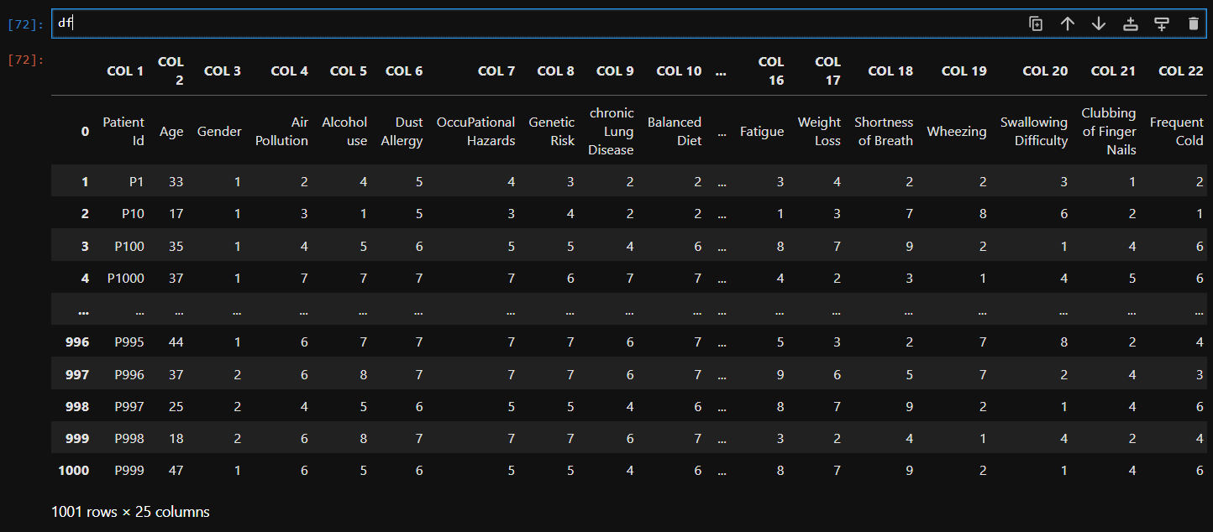
Reading the data from sql database using python connection

Slide 14
DATA CLEANING

Slide 15
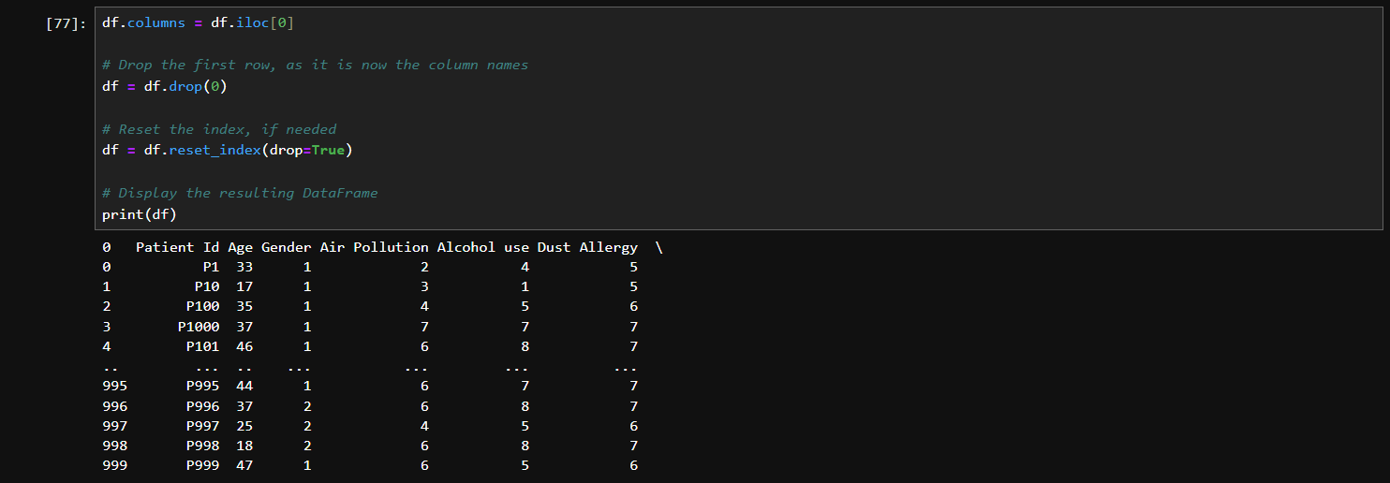
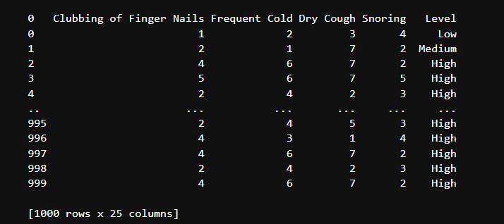
Dropping the first row
We dropped the first row uisng .drop()

Slide 16
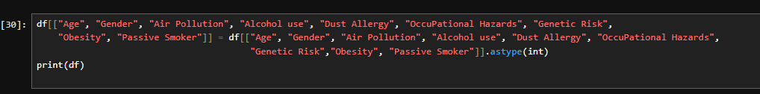
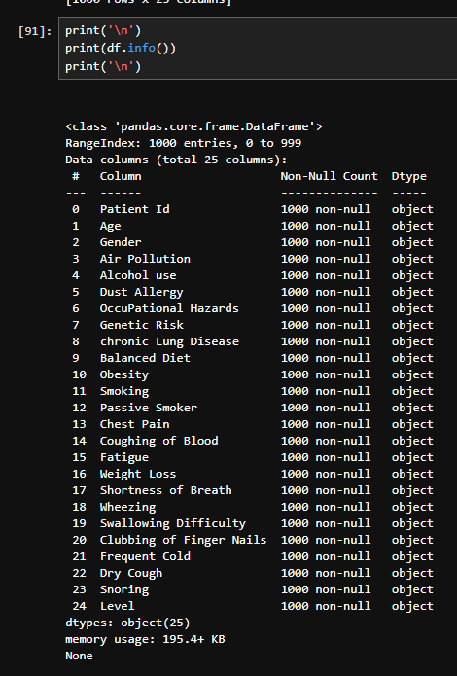
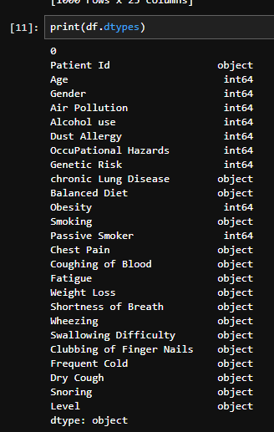
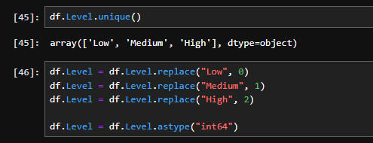
Changing the data types for specific columns required for the data analysis
We changed the data types using .astype()
Checked the data types using .dtypes
Check the uniques values of Level column using .unique()

Slide 17
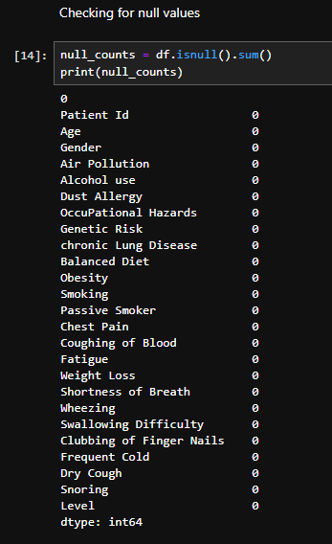
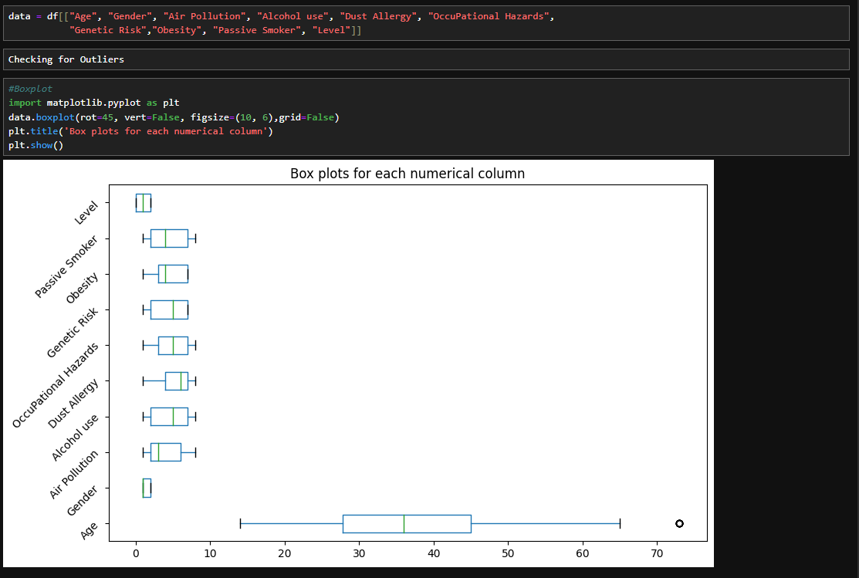
Checking NULL Values and outLiers

Slide 18
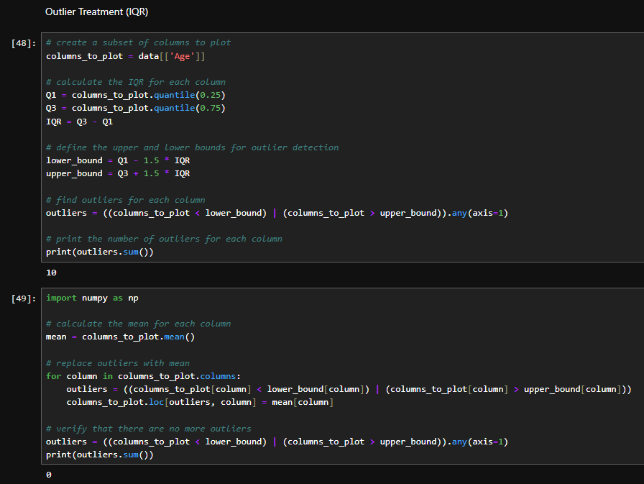
Outlier Treatment (AGE)
We replaced the outliers with mean value. We did this to avoid inaccurate predictions in our machine learning.

Slide 19
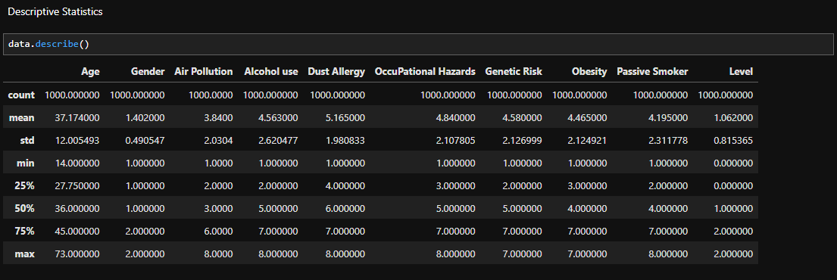
Descriptive statistIcs

Slide 20
DATA VISUaLIZATION

Slide 21
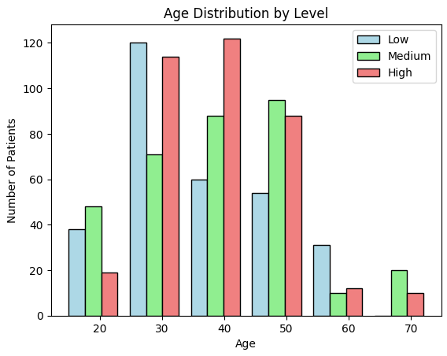
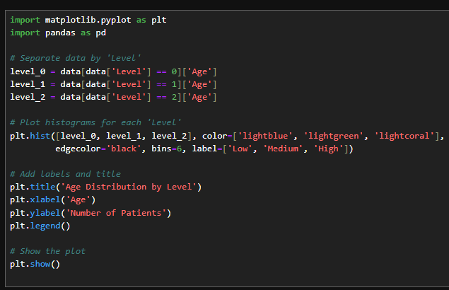
Histogram BASED ON AGE DISTRIBUTION BY LEVEL
Plots are generated using matplotlib library

Slide 22
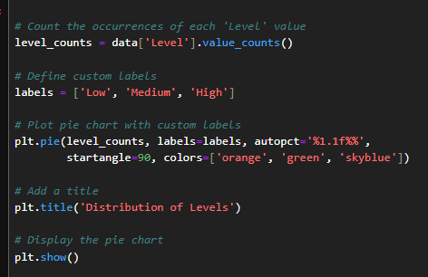
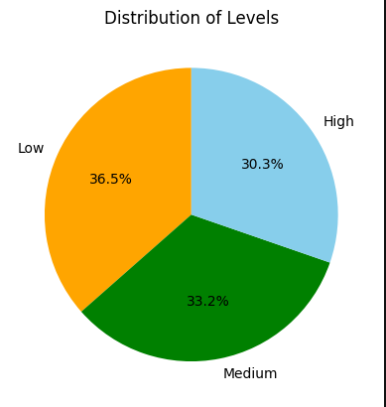
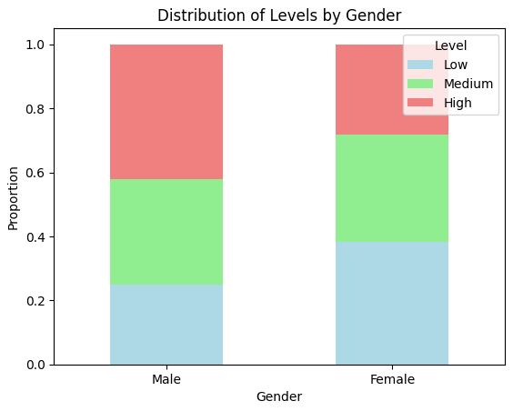
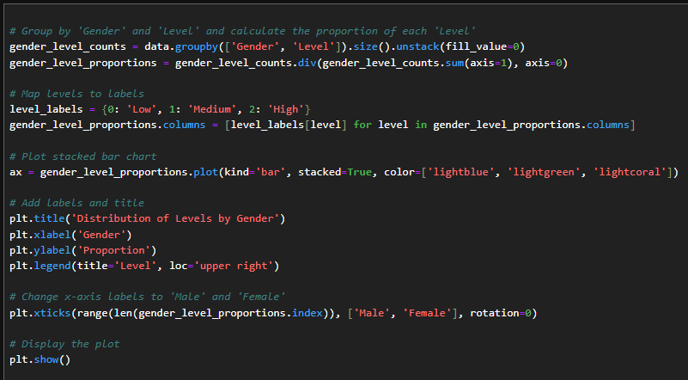
Distribution of levels by gender

Slide 23
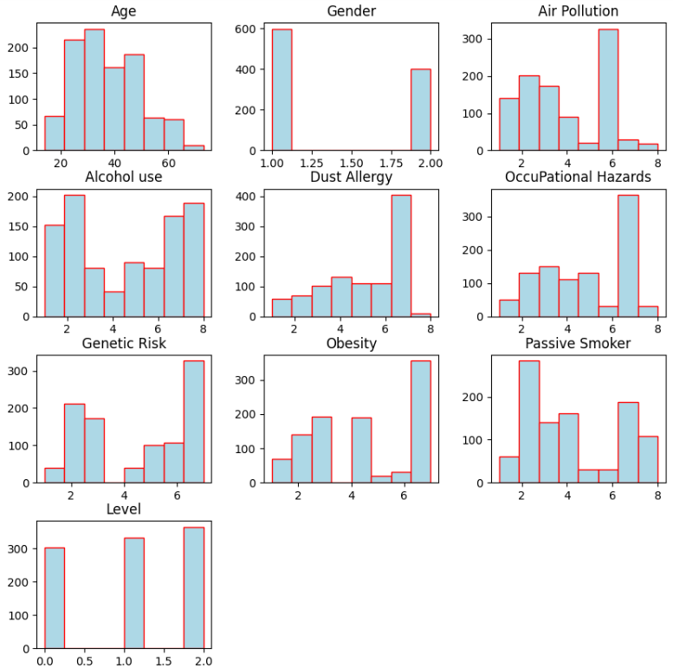
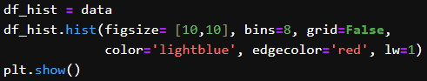
Histogram Distribution of data frame

Slide 24
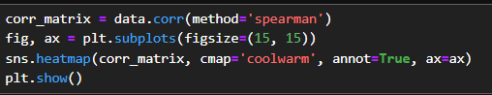
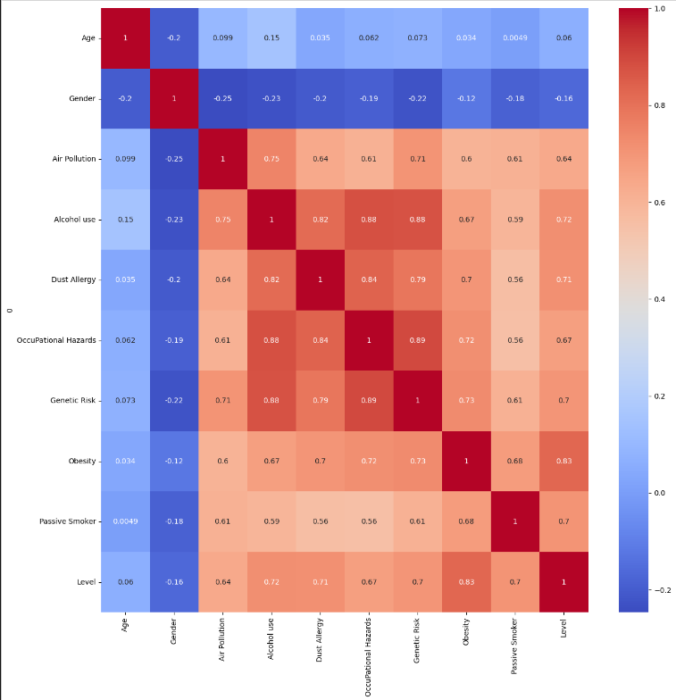
Correlation: Spearman Correlation
Correlation coeeficient of Obesity is 0.83 .
This represents that there is strong relation between Obesity and Level.

Slide 25
Statistical analysis

Slide 26
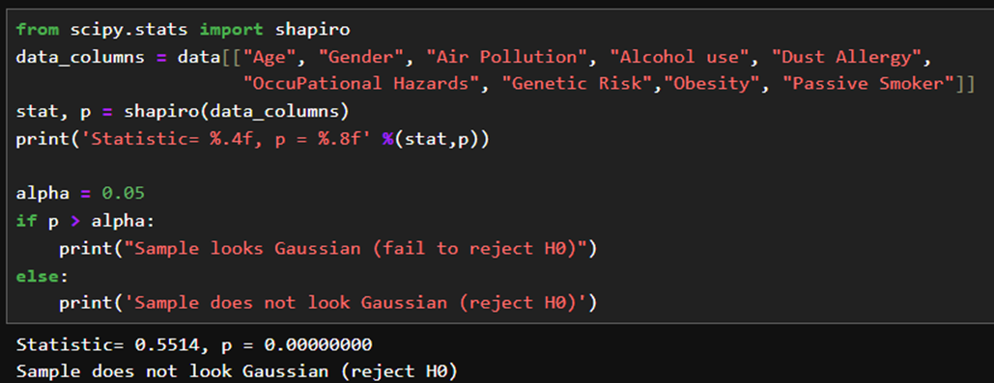
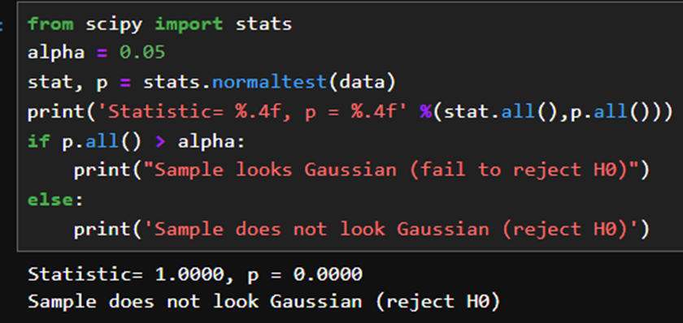
Normality tests: Shapiro-Wilk Test
Normality tests are performed to know the distribution of the data.
The results indicated that they do not follow a normal distribution.
Therefore, we have performed non-parametric tests.
Normality tests using stats

Slide 27
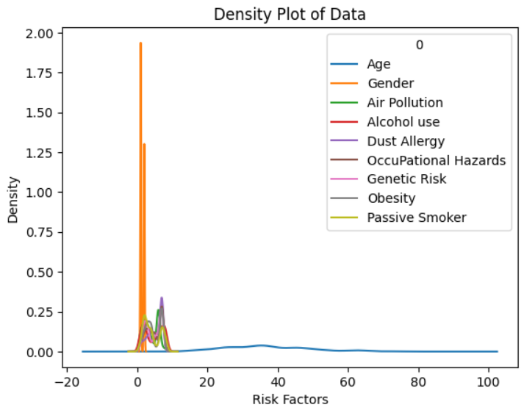
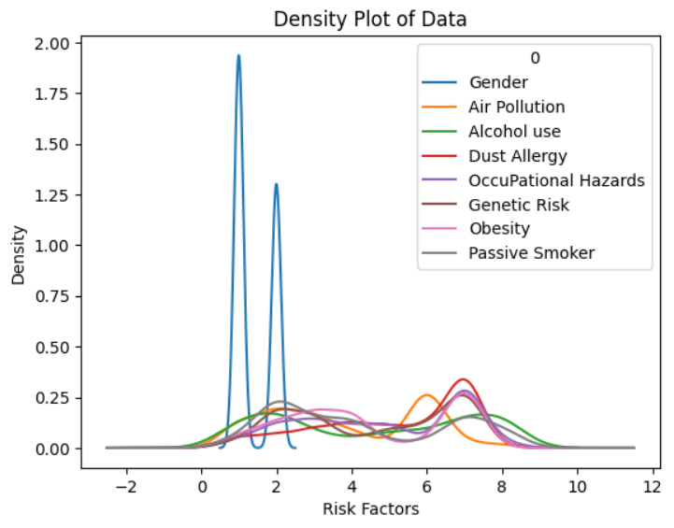
Density plots

Slide 28
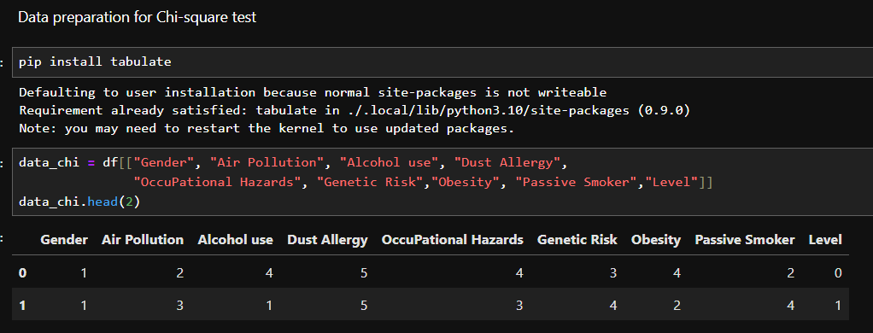
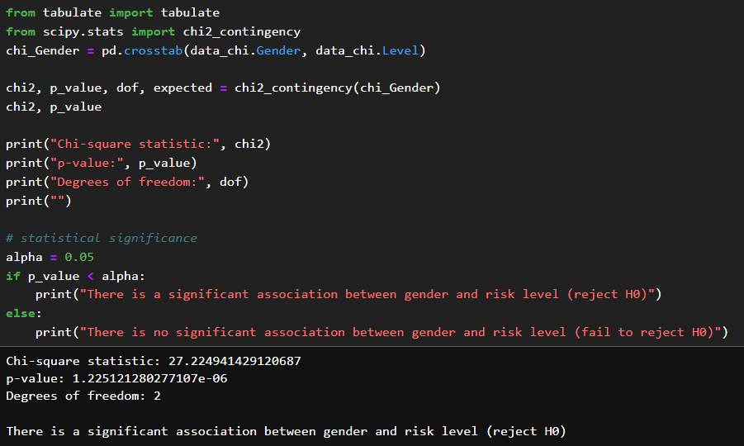
Chi-Square tests
Gender and Level
p-value (1.23e-06) is less than alpha value(0.05)
We rejected the null hypothesis.
There is a significant association between gender and risk level

Slide 29
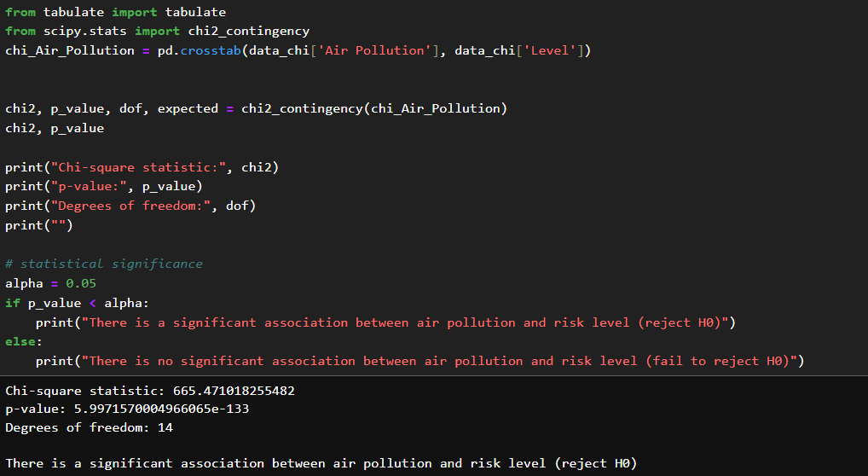
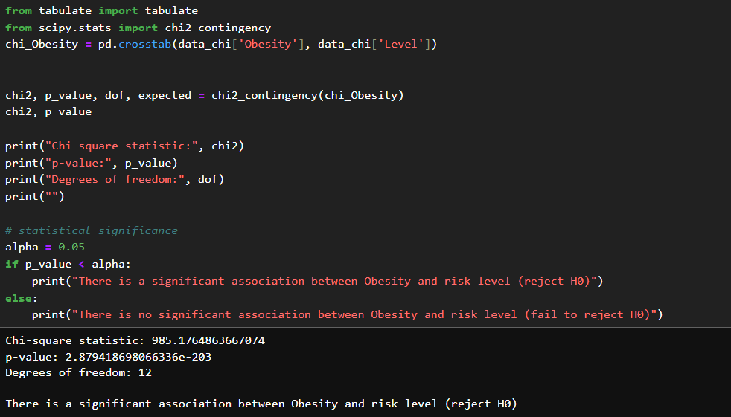
Air Pollution and Level
The test reveals a significant association between Air pollution and risk level rejecting Null hypothesis as the p-value (5.99e-133) is less than alpha value(0.05)
Obesity And Cancer Level
The test reveals a significant association between Obesity and risk level rejecting Null hypothesis as the p-value (2.87e-203) is less than alpha value(0.05)

Slide 30
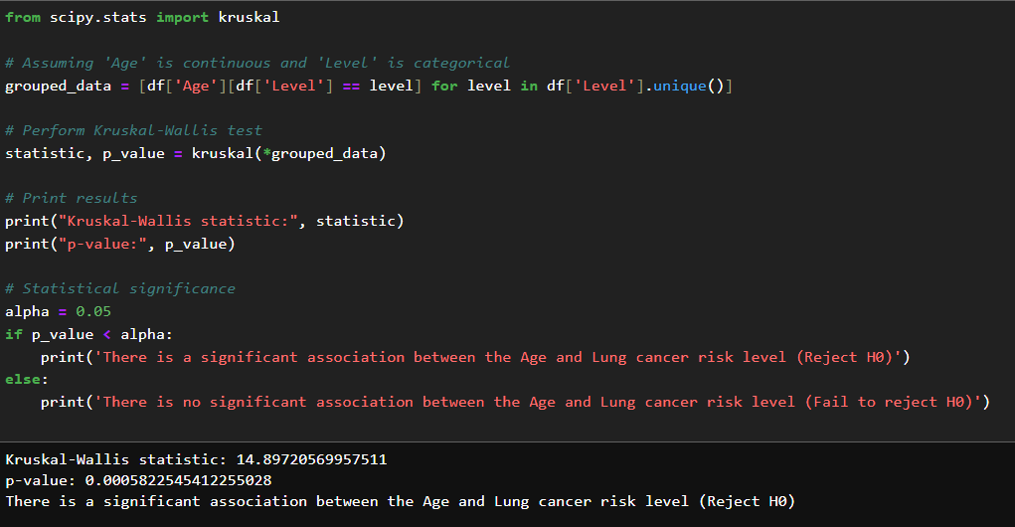
Kruskal-Wallis test
There is a significant association between age and lung cancer

Slide 31
Machine Learning

Slide 32
Machine Learning Models
Classification Models
Random Forest
Guassian Naive Bayes
Decision Tree
Logistic Regression

Slide 33
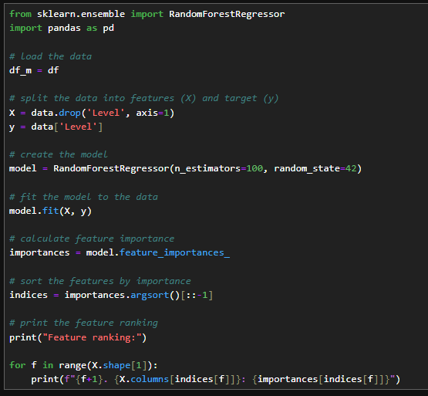
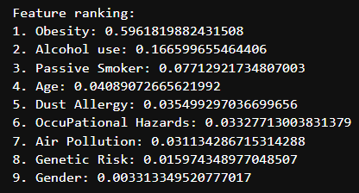
Random Forest Regressor With Feature Ranking
We used feature ranking as it provides insight into the importance of each feature in predicting the target variable ('Level'). The higher the importance score, the more influential the feature is in making predictions.
In our case, 'Obesity' has the highest importance score, indicating that it plays a significant role in predicting the target variable. Similarly, other features are ranked based on their importance.

Slide 34
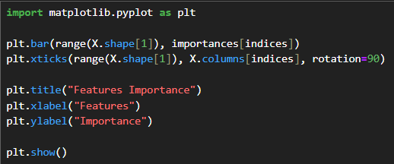
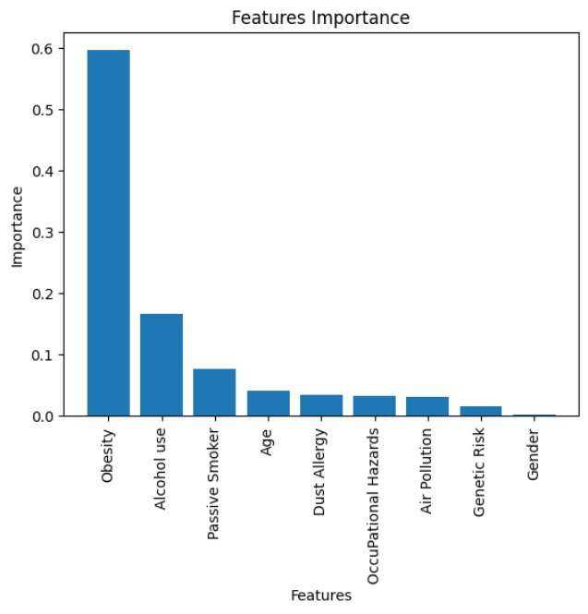
This bar chart illustrates the feature importance scores derived from a Random Forest Regressor model.
Notably, 'Obesity' emerges as the most influential feature, signifying its substantial impact on predicting the target variable, where as, gender is lowest importance.

Slide 35
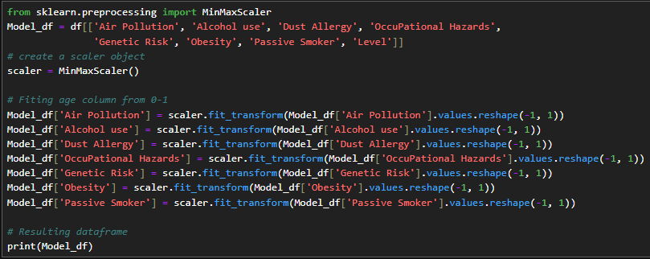
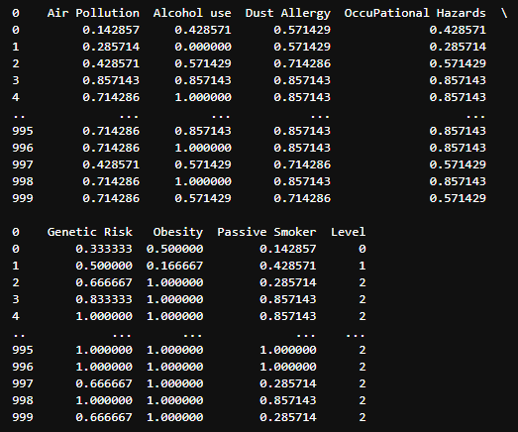
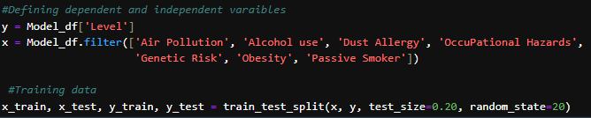
MinMaxScaler technique from the scikit-learn library
We have applied Min-Max scaling to selected features ('Air Pollution', 'Alcohol use', 'Dust Allergy', 'Occupational Hazards', 'Genetic Risk', 'Obesity', 'Passive Smoker') in the Model_df DataFrame. It transforms the values of each feature to a range between 0 and 1.
We prepared our data for training a machine learning model by splitting it into training and testing sets.
The code imports the train_test_split function from scikit-learn and then splits the dataset into training and testing sets with 80% for training (x_train, y_train) and 20% for testing (x_test, y_test)

Slide 36
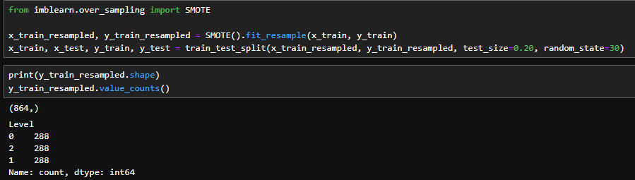
Synthetic Minority Over-Sampling Technique (SMOTE)
The code employs the SMOTE to address class imbalance in the training data (x_train and y_train).
SMOTE generates synthetic instances of minority classes, balancing the class distribution.
The resampled data is then split into training and testing sets, maintaining the oversampling integrity.
The resulting resampled training set has 864 instances, evenly distributed across three classes (Level 0, 1, 2).

Slide 37
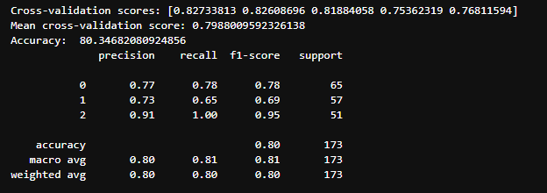
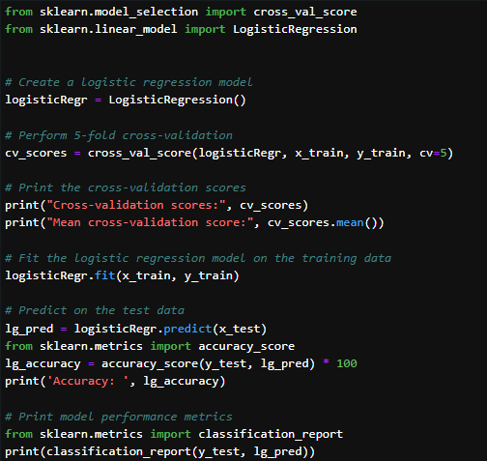
Logistic Regression
The code employs logistic regression for multi-class classification on the provided dataset. It conducts a 5-fold cross-validation, yielding an average accuracy of approximately 79.88%.
The logistic regression model is then trained on the resampled training set (x_train, y_train) and evaluated on the test set, achieving an accuracy of 80.35%.
The classification report provides a detailed breakdown of precision, recall, and F1-score for each class (Level 0, 1, 2), demonstrating the model's performance in predicting each class.

Slide 38
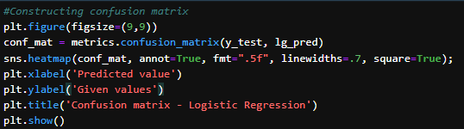
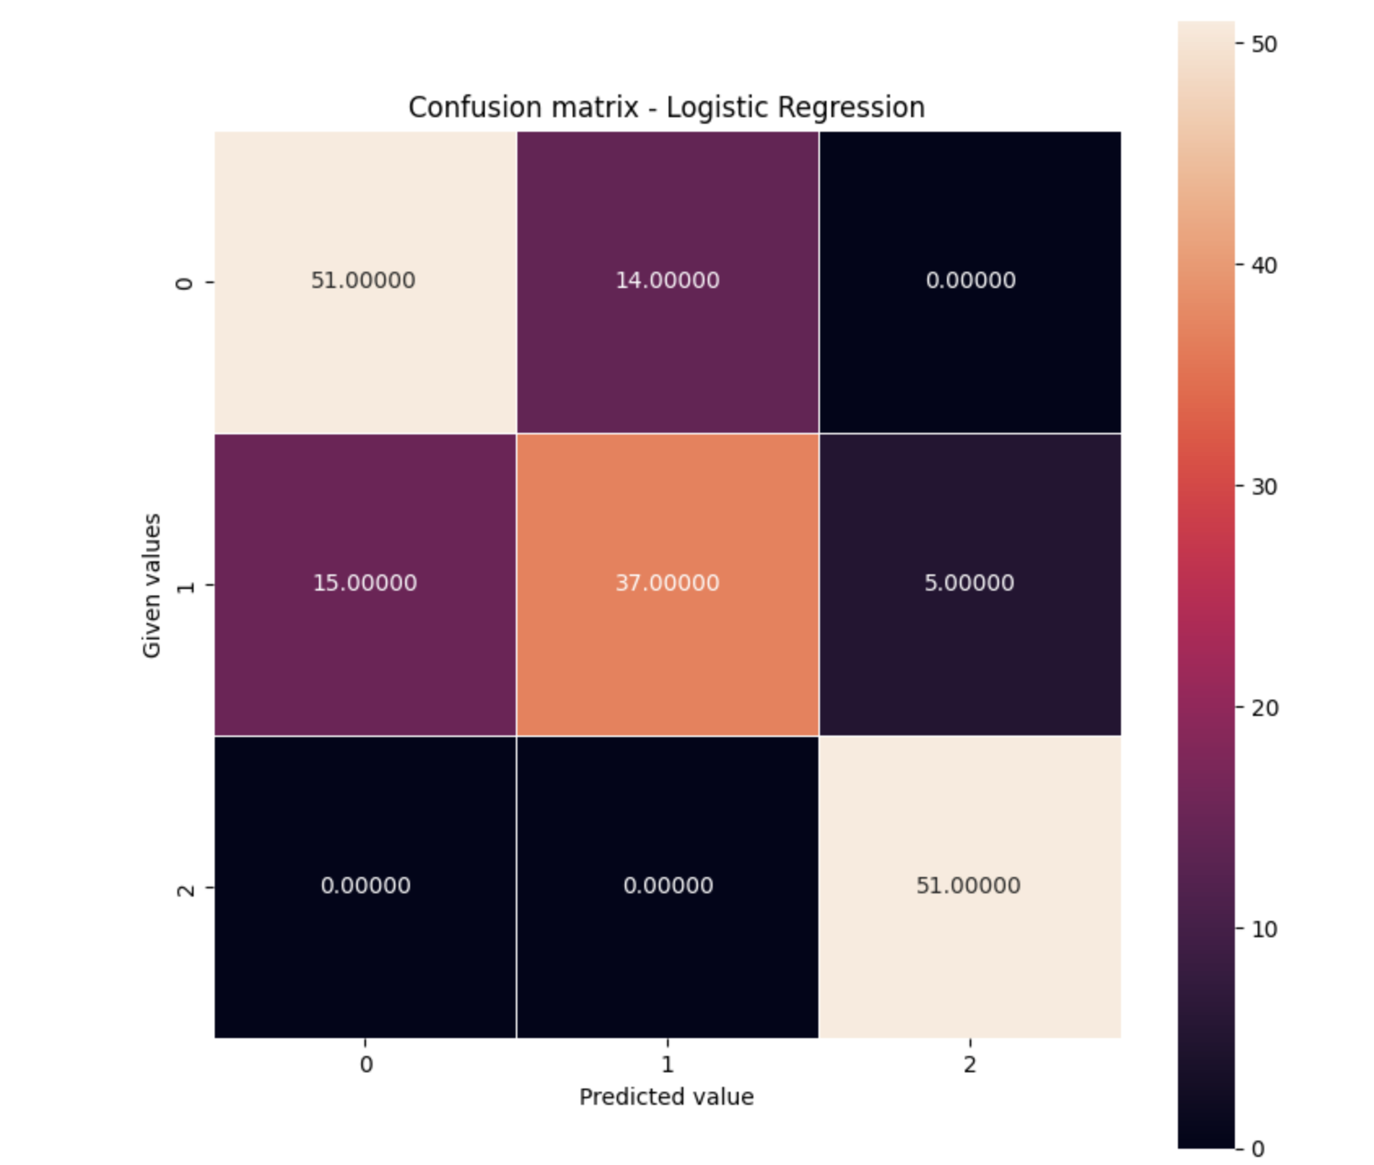
Confusion matrix for Logistic Regression

Slide 39
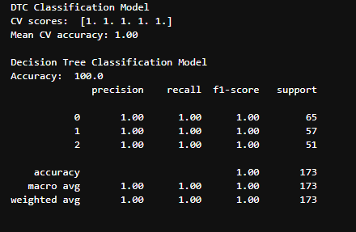
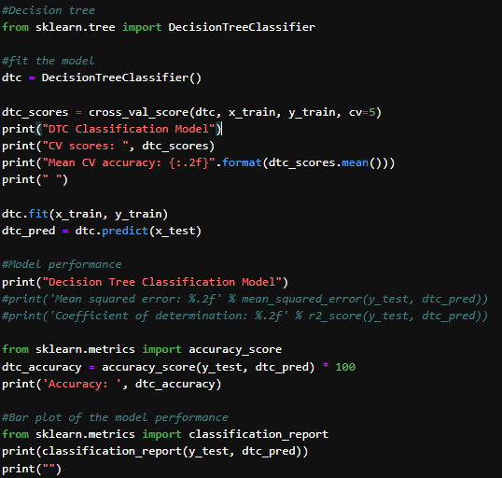
Decision Tree
The above code contains Decision Tree Classification Model, which has mean cross validation of 1 and accuracy of 100%.
This can be considered a best model to prediction.

Slide 40
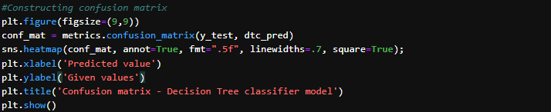
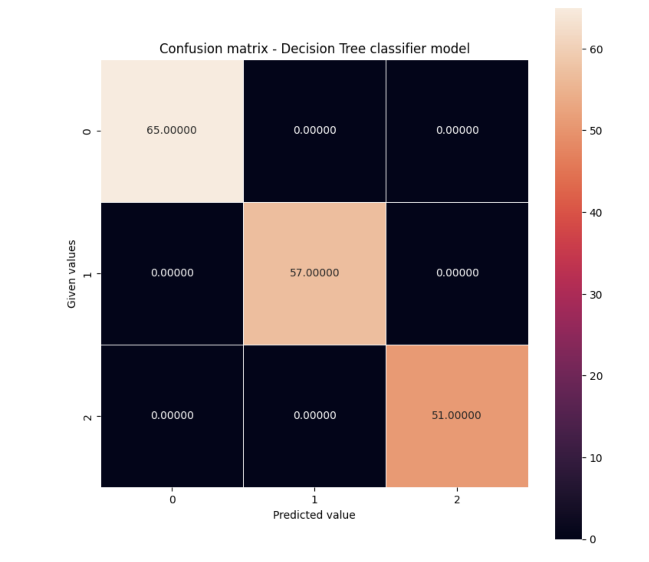
Confusion matrix for Decision Tree

Slide 41


Gaussian Naive Bayes
The above model exhibits moderate performance with a mean cross-validation accuracy of 62%.
During testing, the model achieves an accuracy of 70.52%, demonstrating fair predictive capability.

Slide 42


Confusion matrix for Gaussian Naive Bayes

Slide 43


Random Forest Classification
The Random Forest Classification Model achieves exceptional performance, demonstrating perfect cross-validation accuracy (100%) and 100% accuracy on the test set.
This model can also be considered as a best model for prediction.

Slide 44


Confusion matrix for Random Forest

Slide 45


Bar plot to compare the Model performance

Slide 46

Classification accuracy scores for four Machine learning models
Among the four models, Decision tree and Random forest classifier was the best-fitting model
The Decision Tree and Random Forest models achieved perfect accuracy (100%), suggesting they correctly predicted all instances.

Slide 47

ROC Curve

Slide 48
Results

Slide 49
Results
We are rejecting the null hypothesis
There is a significant association between the risk factors and the levels of lung cancer.
Among all the factors, Obesity has a high correlation with the lung cancer risk.
Random Forest and Decision Tree Models are considered the best machine learning models for prediction.

Slide 50
Limitati0ns

Slide 51
Limited dataset: The dataset only contains 1000 patients, which may limit the ability to train highly complex machine learning models or detect subtle patterns in the data. More data would strengthen the analysis.
Focus on a limited set of risk factors: The analysis is focusing on a handful of risk factors like smoking, occupational hazards etc. But there may be other important risk factors not captured in the data that could improve prediction.

Slide 52
References

Slide 53
Ahmad, A. S., & Mayya, A. M. (2020). A new tool to predict lung cancer based on risk factors. Heliyon, 6(2), e03402. https://doi.org/10.1016/j.heliyon.2020.e03402
Darling, G., Tammemägi, M. C., Schmidt, H., Buchanan, D., Leung, Y., McGarry, C., &
Rabeneck, L. (2021). Organized Lung Cancer Screening Pilot: Informing a Province-
Wide program in Ontario, Canada. The Annals of Thoracic Surgery, 111(6), 1805–1811.
https://doi.org/10.1016/j.athoracsur.2020.07.051
International Agency for Research on Cancer. (2012). Chemical agents and related occupations.
NCBI Bookshelf. https://www.ncbi.nlm.nih.gov/books/NBK304416/
Rushton, L., Hutchings, S., Fortunato, L., Young, C., Evans, G. S., Brown, T., Bevan, R., Slack,
R., Holmes, P., Bagga, S., Cherrie, J. W., & Van Tongeren, M. (2012). Occupational
cancer burden in Great Britain. British Journal of Cancer, 107(S1), S3–S7.
https://doi.org/10.1038/bjc.2012.112

Slide 54
Appendix

Slide 55



Installing packages

Slide 56

Chi-Square Tests
Dust Allergy and Cancer risk level

Slide 57


Occupational Hazards and cancer risk level
Alcohol use and Cancer risk level

Slide 58


Passive smoker and Cancer risk level
Genetic risk and Cancer risk level

Slide 59

CODE FOR ROC CURVE

Slide 60
THANK YOU

